Slide 1
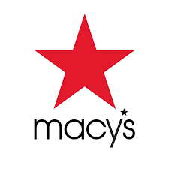
A deep dive into Macy’s

Slide 2
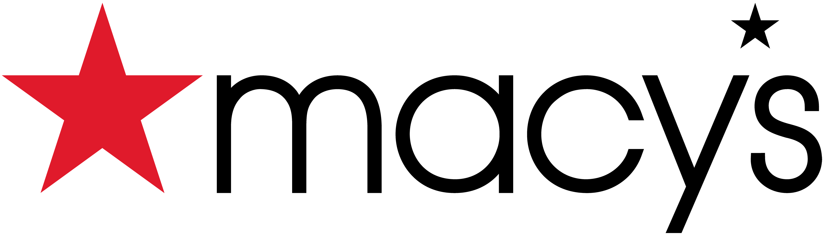
Macy's (originally R. H. Macy & Co.) is an American chain of high-end department stores founded in 1858 by Rowland Hussey Macy.
Macy’s mission is - to create a brighter future with bold representation.
Rowland Hussey Macy adopted a red star as his symbol of success, dating back to his days as a sailor.
Macy has a brand promise as - We will win with fashion and style by delivering products that meet core and new customer needs across all occasions and transforming our assortment architecture, fashion curation, inventory productivity and vendor relationships.
Macy's as of October 29, 2022, has 510 stores throughout United States
Company Description

Slide 3
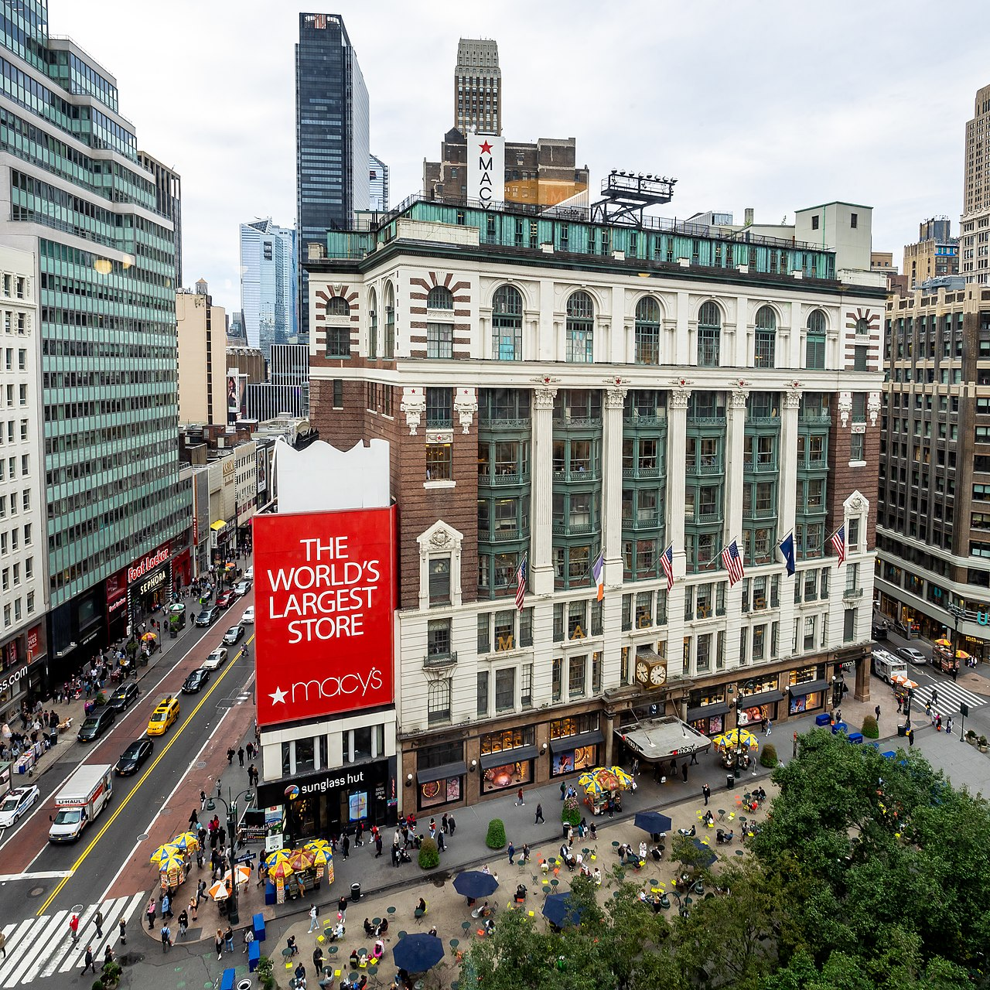
Macy's target consumers for the Macy's brand stores are the American middle class who prefer quality products at reasonable prices.
Macy's is renowned for having excellent customer relationship management.
Valuable Brand: Since its founding, Macy's operations were driven by customer-centric strategies.
Macy's is ranked 120th by Fortune in Fortune 500 Companies.
Company Target

Slide 4
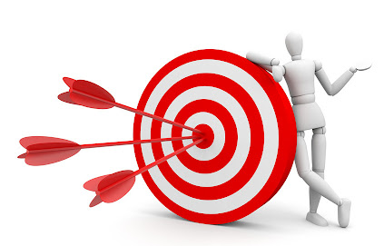
Expanding usage of data-driven insights that fuel efforts to meet customer needs.
Accelerating economic growth through Product/brand/supplier expansion.
Directing company’s spend towards technology architecture, data science applications for retail operations, digital platform enhancements, and further upstream, and personalization efforts.
Enhancing digital marketplace and launching new offerings.
Building upon strong merchandise foundation with key categories.
Increase engagement through marketing and the star rewards Loyalty Program.
Business Objectives

Slide 5
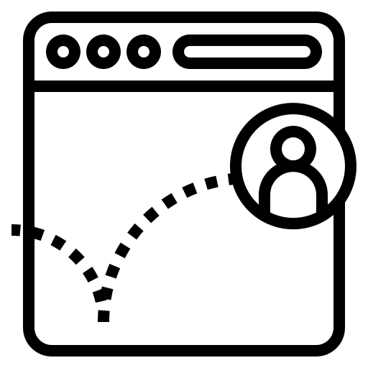
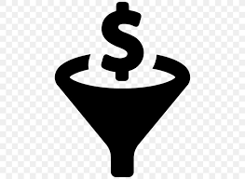

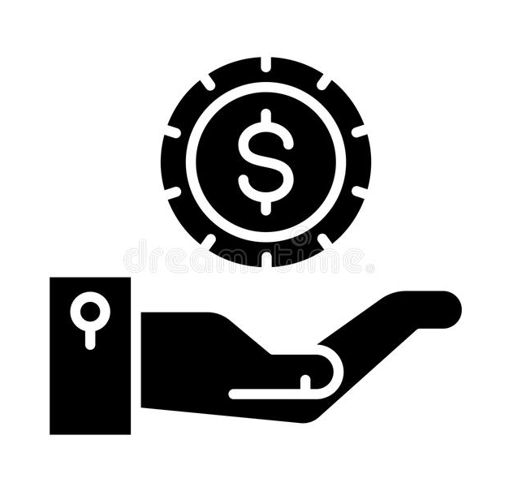
Bounce Rate - Bounce rate is single-page sessions divided by all sessions, or the percentage of all sessions on your site in which users viewed only a single page and triggered only a single request to the Analytics server
Conversion Rate - Conversion rate is the percentage of visitors to your website that complete a desired goal (a conversion) out of the total number of visitors. A high conversion rate is indicative of successful marketing and web design: It means people want what you’re offering, and they’re easily able to get it.
Key Performance Indicators
Average Order Value - Average order value (AOV) tracks the average dollar amount spent each time a customer places an order on a website or mobile app. To calculate your company's average order value, simply divide total revenue by the number of orders.
Revenue Per Visit - Revenue Growth is a KPI used to measure how sales are increasing or decreasing over time. It is calculated by dividing revenue generated during one time period by the revenue generated during a subsequent time period, subtracting 1, and then multiplying by 100 to obtain a percentage.

Slide 6
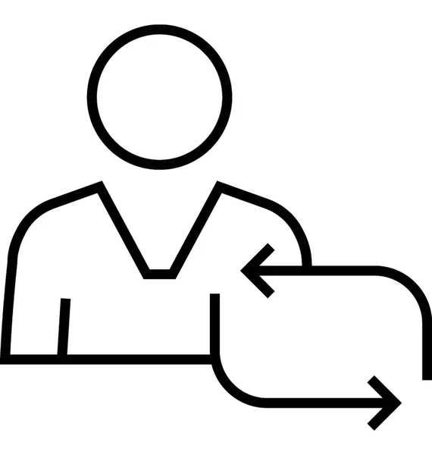


New users VS Returning User - New users are users who have never been to your website, according to Google’s tracking snippet; returning users have visited your site before.
Sessions Per User - Sessions per User counts the average number of sessions initiated by each user or visitor to your website/application. This metric is mainly used to determine how frequently users return to your website or app.
Metrics
Average Session Duration - Average session duration’ is a metric that measures the average length of sessions on your website. Google Analytics begins counting a session from the moment a user lands on your site, and continues counting until the session ends

Slide 7
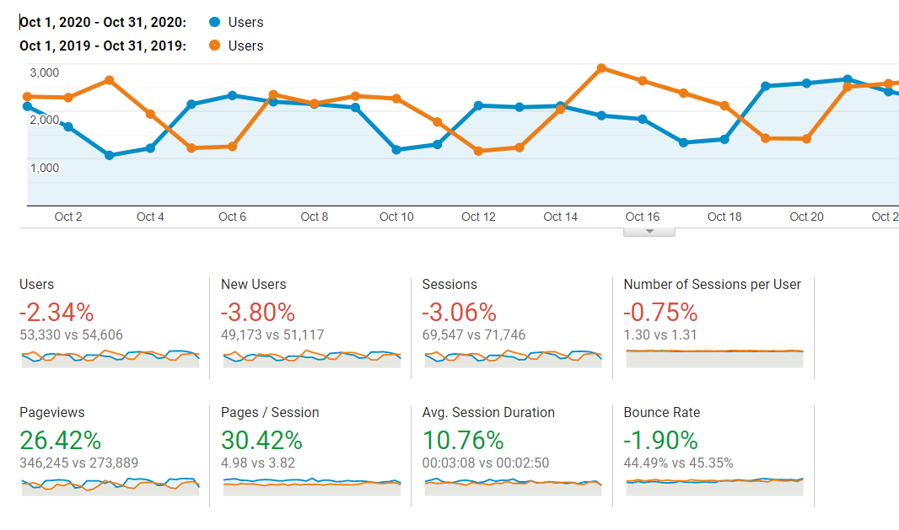
Bounce Rate

Slide 8
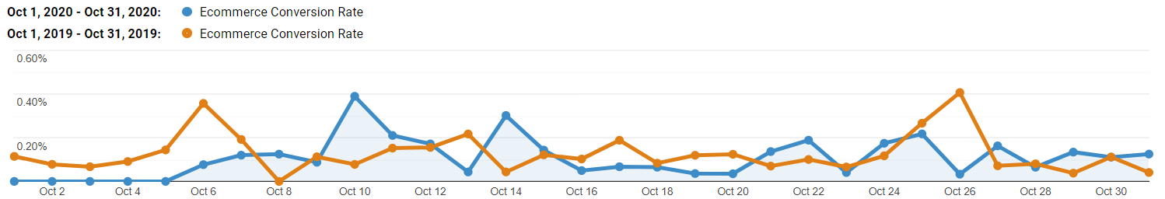
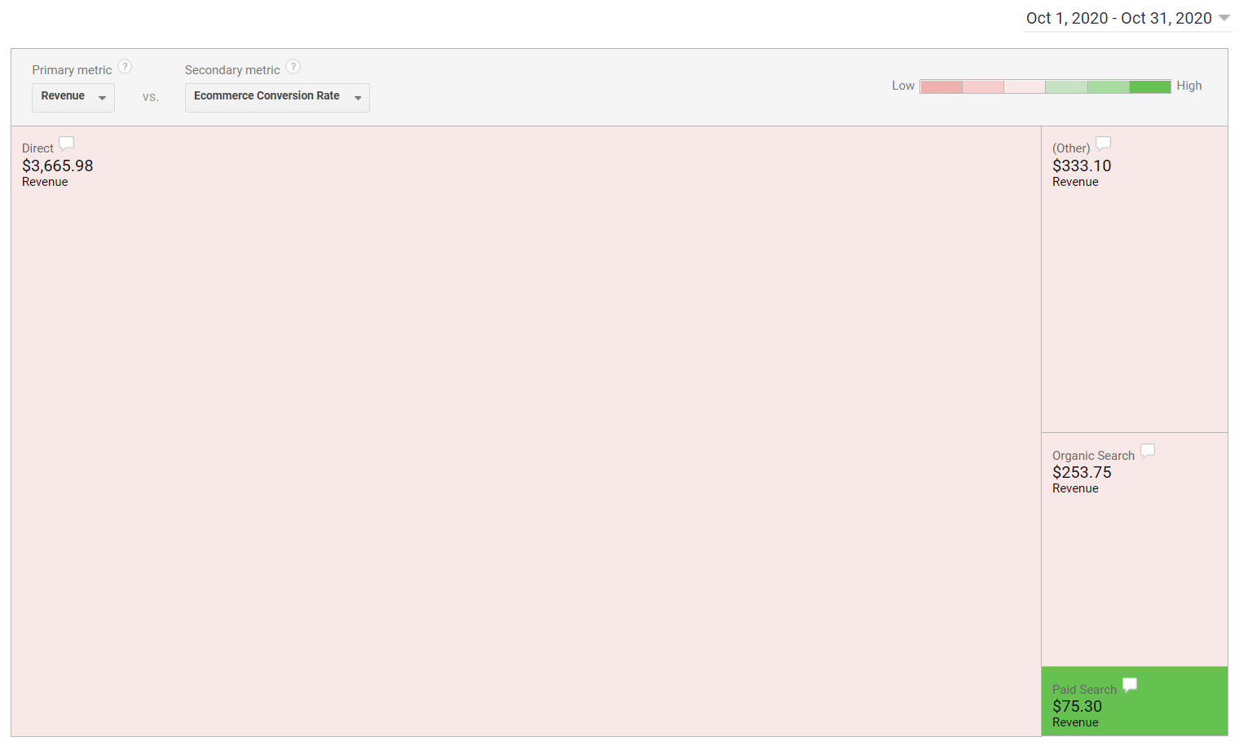
Conversion Rate
Overall: Decreased by 10.51%
Paid Search: highest conv rate.
Best hour: 4 pm
Landing page: Men’s T-shirt
Notes:
YoY comparison:
Overall: Decreased by 10.51%. Although we have a high page/session rate compared to last year.
Landing pages: Increased by 40% for home page, Men’s T-shirt.
Marketing channels: Less conversion through direct load and organic searches (~20-40% decrease). Paid searches increased in conversion.
Hour of day: Best time of day for highest conversion is 1600 or 4 pm.
Insight:
Macy’s has improved as an engaging platform but with low conversion rate
More promotion for men’s t-shirts since it is having the highest conversion among different landing pages.
Invest more into paid searches as we see higher conversion there.
Most purchases happen at 4 pm

Slide 9
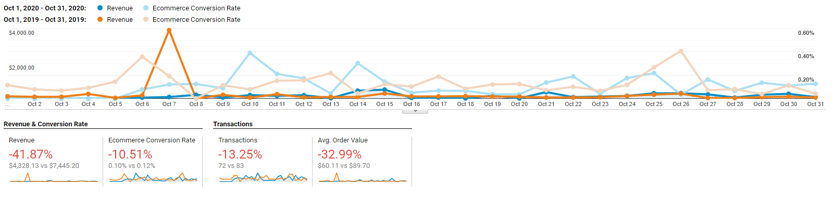
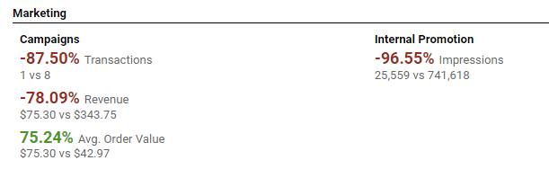
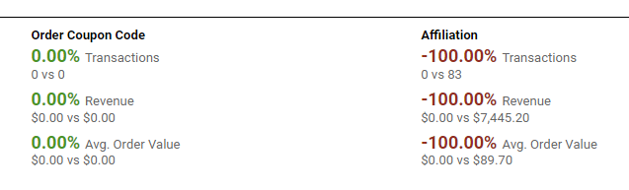
Average Order Value

Slide 10
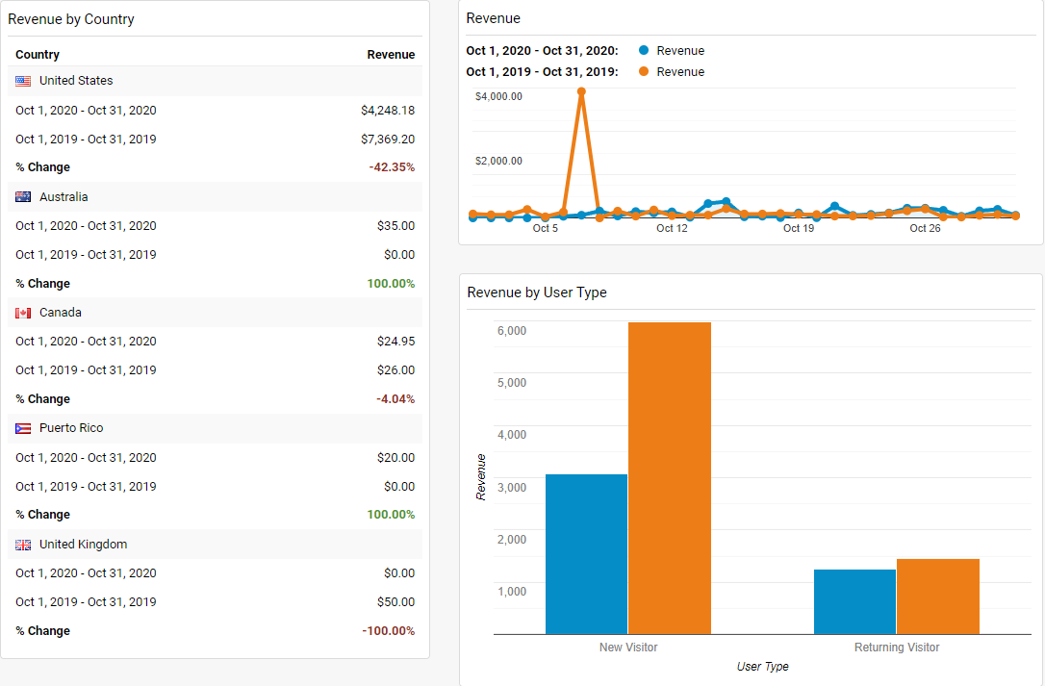
Revenue

Slide 11
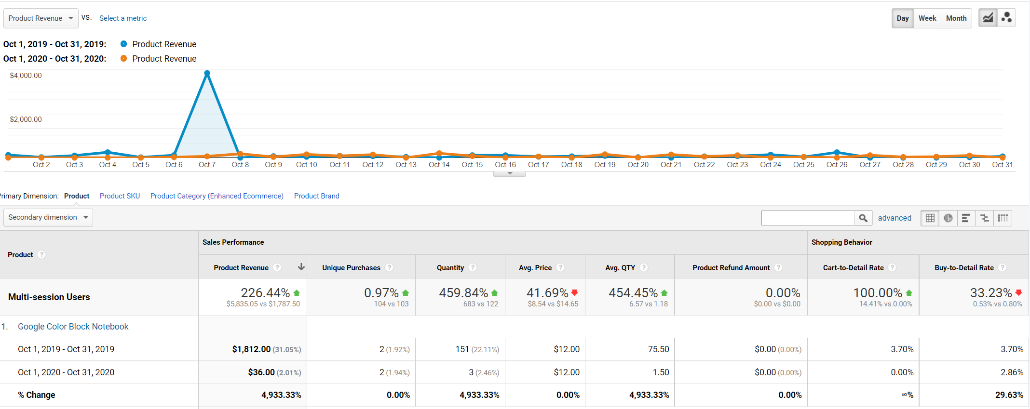
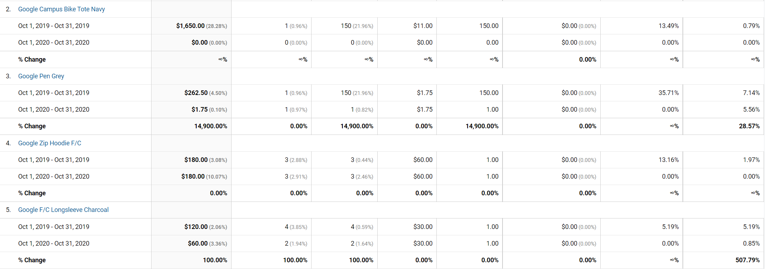
Top 5 Products by Revenue

Slide 12
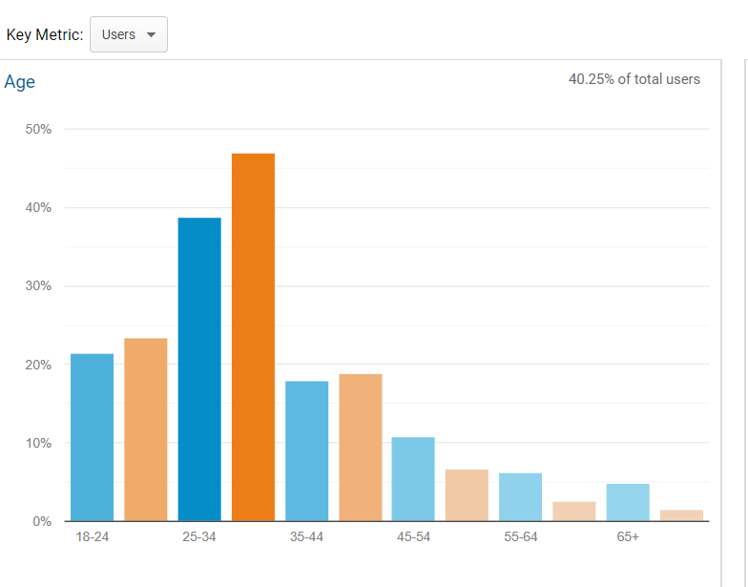
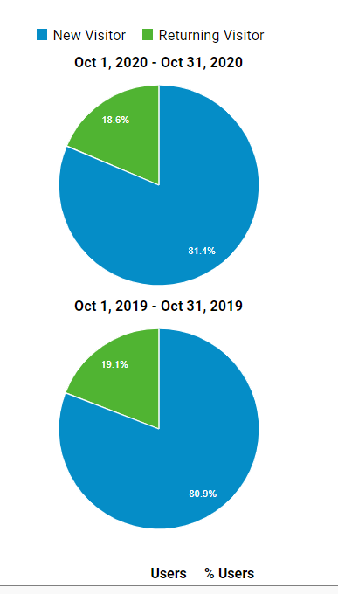
New Users Vs Returning Users
and Distribution by age group

Slide 13
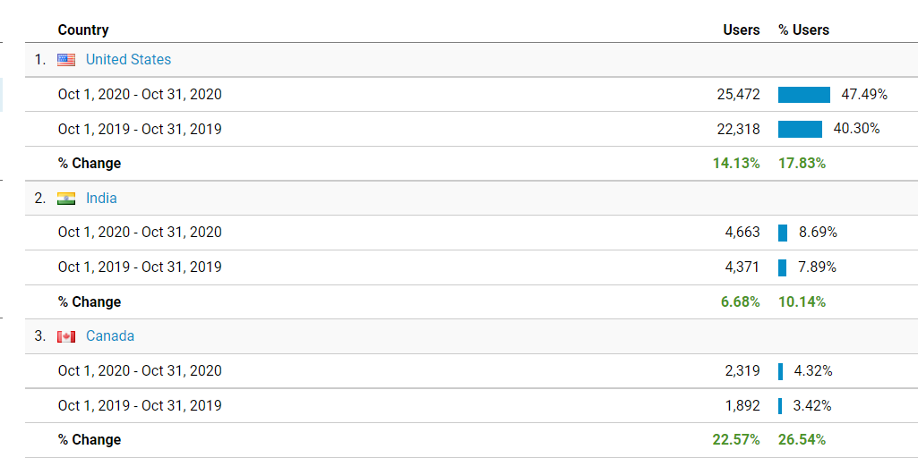
Top 3 Countries with New Users Percentage

Slide 14
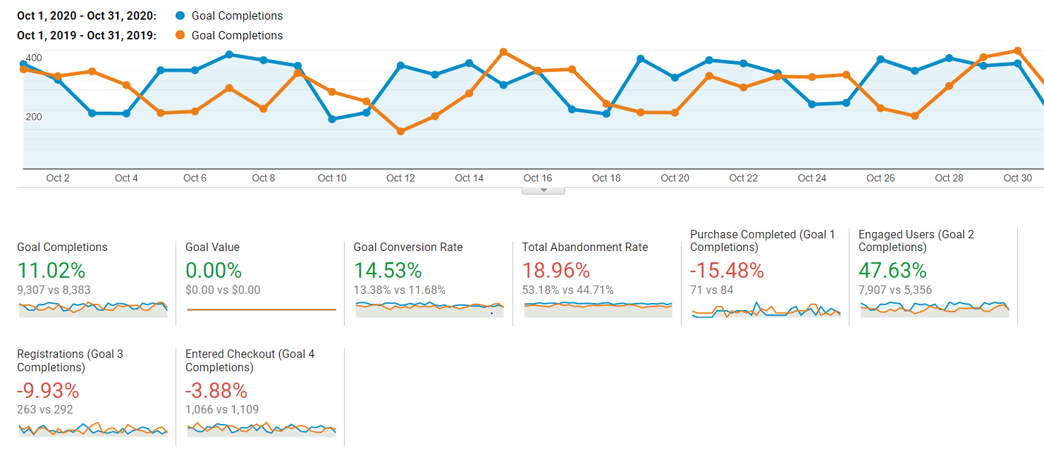
Goal Completion Trend

Slide 15
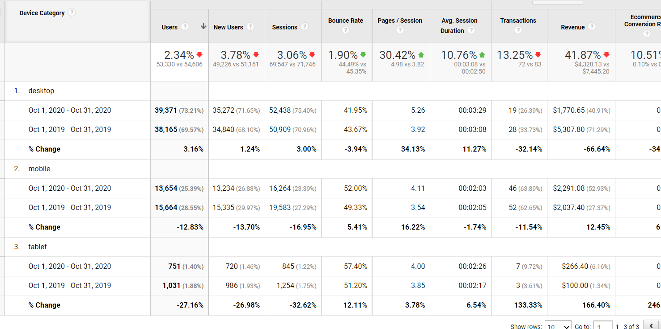
Channel Traffic

Slide 16
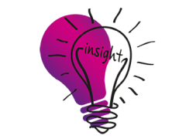

Revenue:
Sale and promotions in 2020 probably did not work as expected, since we had low revenue.
Sales and revenue reduction could be because of COVID 19 Pandemic.
Customer Engagement:
Despite a decrease in Revenue, there is a significant increase in AOV.
Despite decrease in conversion rate, average page depth is improved.
Products:
Zip Hoodie F/C is our highest selling product.
Men’s t-shirt is the landing page with highest conversion.
Target Market:
Ages 25 to 35 tends to shop from Macy's a lot.
47% of users are from USA. Followed by India and Canada with 4.32%.
Goal conversion rate is 14.53% higher in the year 2020 vs 2019.
Paid searchers has the highest conversion
Insights
Notes:
Macy’s has improved as an engaging platform but with low conversion rate
More promotion for men’s t-shirts since it is having the highest conversion among different landing pages.
Invest more into paid searches as we see higher conversion there.
Most purchases happen at 4 pm

Slide 17
Macy's should focus more on customer satisfaction using customer surveys/feedbacks as the number of returning users are decreasing.
Company should work more on improving the performance of mobile application and website design in order to drive customers to next page.
Bonus/ Credit points can be given to all the customers for their purchase and for posting a review which can help in customer retention.
From the AOV we can find that the marketing team could improve the campaign products plus some target promotion to help with increasing the revenue.
The company must have faced Covid pandemic, and we can see a significant drop in new customers as well as returning customers, cause the Revenue has dropped since 2019.
It is always recommended that the bounce rate should be as low as possible. And thus, to decrease the bounce rate, Macy can create attractive layouts and user interface for the application and website which would make customer dive into other pages to make a purchase.
Our Recommendation

Slide 18
In summary,
Overall, Macy's existing users, new user sessions, and the number of sessions per user have decreased, whereas pageviews, page/session, average session duration, and bounce rate have decreased from Oct 2019 to Oct 2020
Progress in terms of a higher Average order value and new users' percentage. Macy's needs to find a way to retain existing customers and introduce additional new users.
In terms of top products, revenue has increased; namely, the zip hoodie F/c, clear framed gray shades, F/c long sleeve ash, heather green speckled tee and perk thermal tumbler. Overall marketing for these products should remain constant, along with increased marketing for other products.
Improvement in total abandonment rate, purchase completed, registrations, and entered checkout is required.
Revenue from marketing campaigns and internal promotions is decreasing; a change in the strategy is recommended.
Conclusion

Slide 19


